Slide 1


IBMHack 2020
AI Recruiter ChatBot
Bias-free Shortlist a Suitable Candidate for Specific Job Role
Team:
DataVengers

Slide 2




DataVengers
IBMHack 2020
Chetan Mehatre
Team Lead
Python, ML, NLP, DL, Business Analytics, Ethical AI
M Venkateshwar Reddy
Member
Python, ML, CPP
Data Structures, Algorithms
Raghavendra Biradar
Member
Python, CPP,
Data Structures, Algorithms
Vaibhavi Gadgi
Member
Python, ML, NLP, App Development, Data Structures
Notes:
V

Slide 3


Problem Statement
Proposed Solution
IBMHack 2020
52% of talent acquisition leaders say that the most difficult part of their job is to shortlist the right candidate and 3% of candidates never hear back from a company after one touchpoint.
On the flip side, it’s a challenge for employers to communicate well with all their candidates.
For high volume recruiting, this would require communicating with thousands of candidates, in addition to a recruiter’s normal screening functions and other duties.
Artificial Intelligence enabled software bots can definitely provide a solution to this problem.
Build an AI-enabled Software Bot to:
Collect information of candidate
Identify his skills & personality traits through conversation.
Screens the candidate application
Bias-free shortlist based on ranking
Send email to shortlisted candidate for further recruiting process
.

Slide 4

Block Diagram
IBMHack 2020
Collects the interest of job role from the applicant
Send a google form link to collect further details and resume.
Apply NER
and Reranking
AI Bot
NO
Have required skills
NO
Wait till user
responds
Reject candidate
Send mail to the candidates regarding details of further interview process

Slide 5

Implementation Details
IBMHack 2020
Technology Stack
Python3
NLP
spaCy: For resume summarization.
PyPDF2: Working with Resumes.
IBM Watson Assistant for Chatbot creation
Watson Chatbot
Algorithms
Named Entity Recognition
Reranking Algorithm
DetGreedy
DetCons
DetRelaxed
DetConstSort
3. Automated Emailing

Slide 6
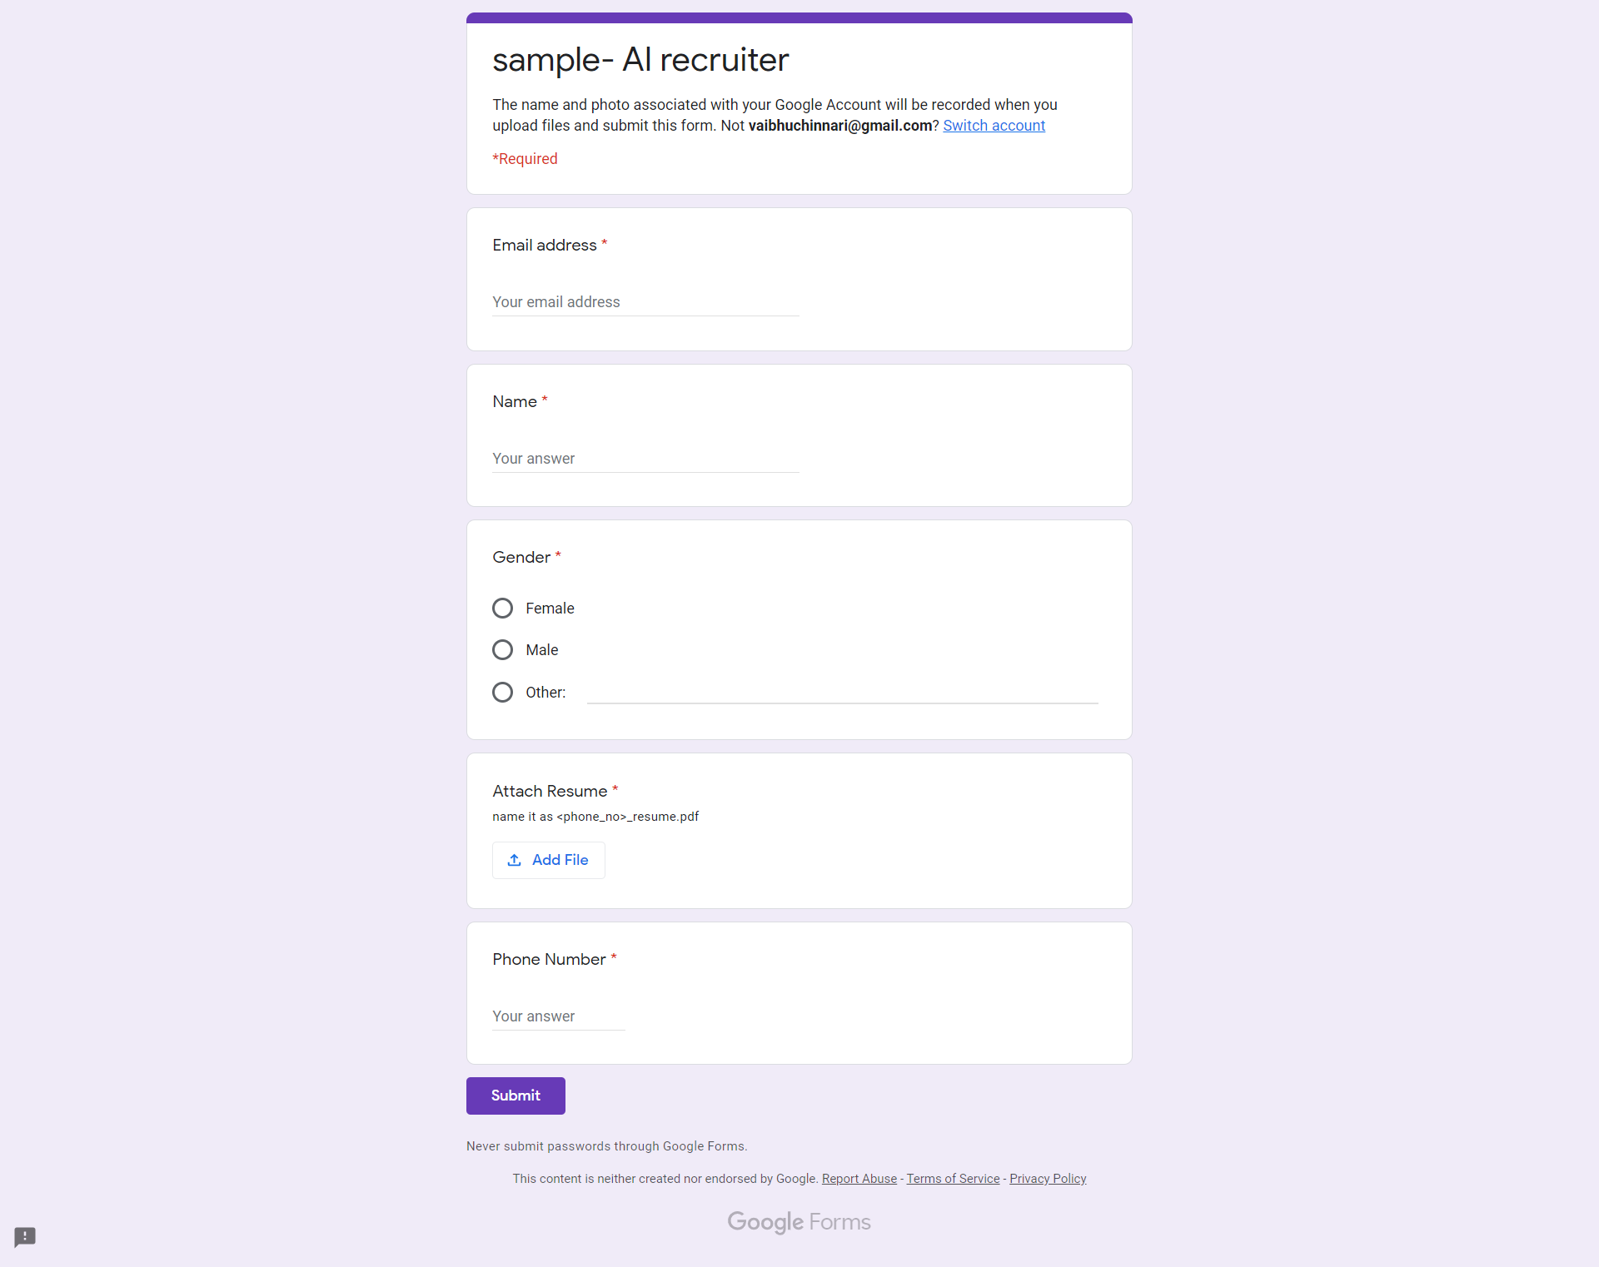
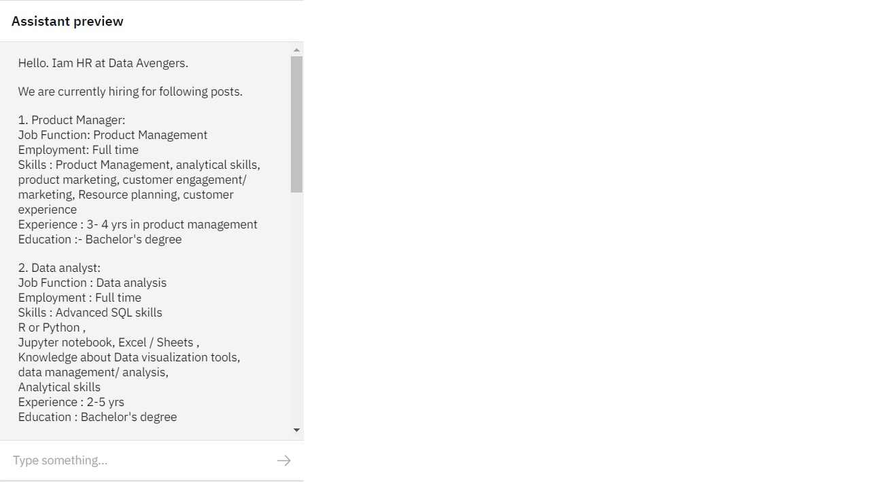
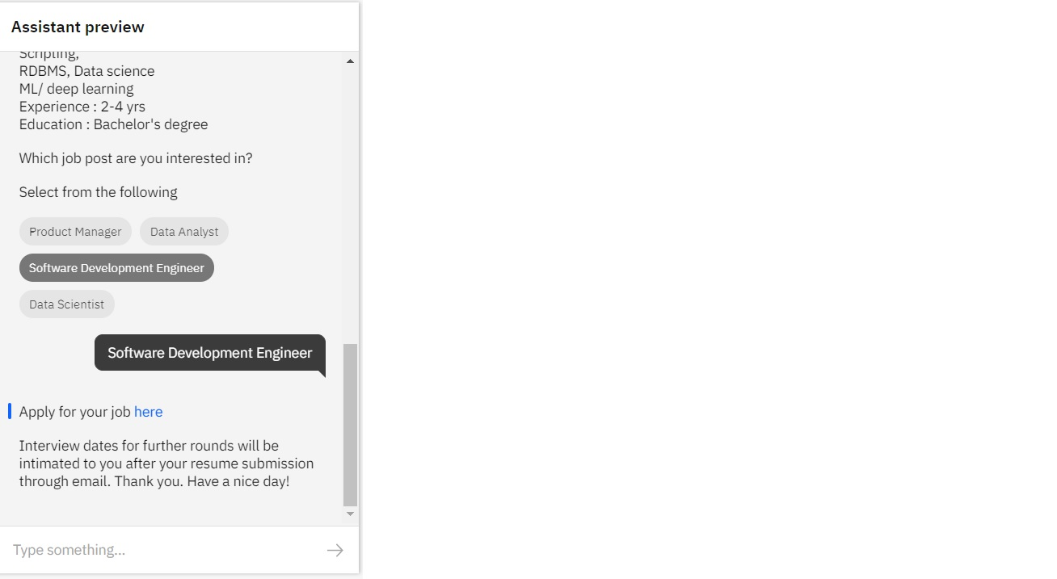
Results
IBMHack 2020
Chatbot preview
Google Form

Slide 7
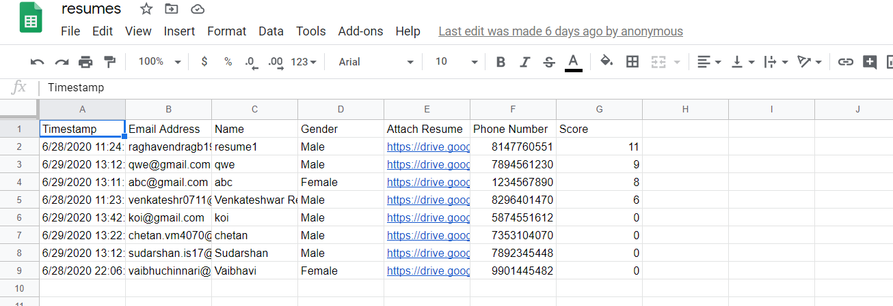
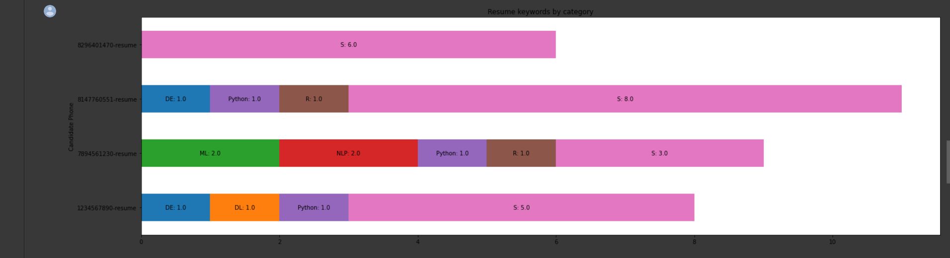
Results
IBMHack 2020
CSV file after adding score
Graphs after parsing candidates resume.

Slide 8
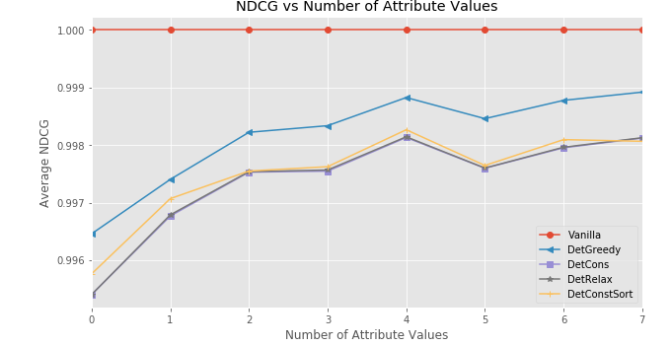
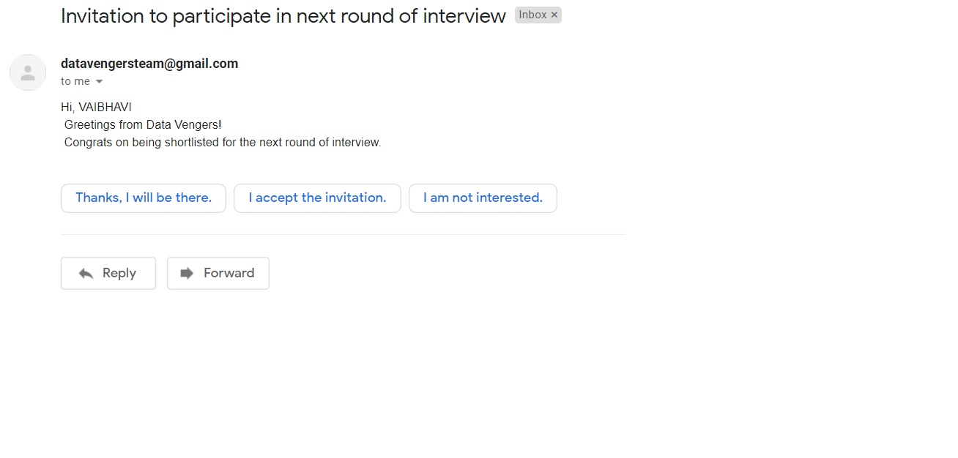
Results
IBMHack 2020
Reranking Algorithms
Screenshot of mail

Slide 9
Future enhancement
IBMHack 2020
Integrating Google Calendar API with the Application for sending Google meet link to shortlisted candidates through automated mailing.
Run Re-Ranking algorithms with real world dataset. Integrate, evaluate and deployment in practice
Reference
1. https://marutitech.com/14-powerful-chatbot-platforms/
2. https://chatbotsmagazine.com/how-to-develop-a-chatbot-from-scratch-62bed1adab8c
3. https://ideal.com/recruitment-chatbot/
4. Fairness-Aware Ranking in Search & Recommendation Systems with Application to LinkedIn Talent Search https://arxiv.org/abs/1905.01989

Slide 10
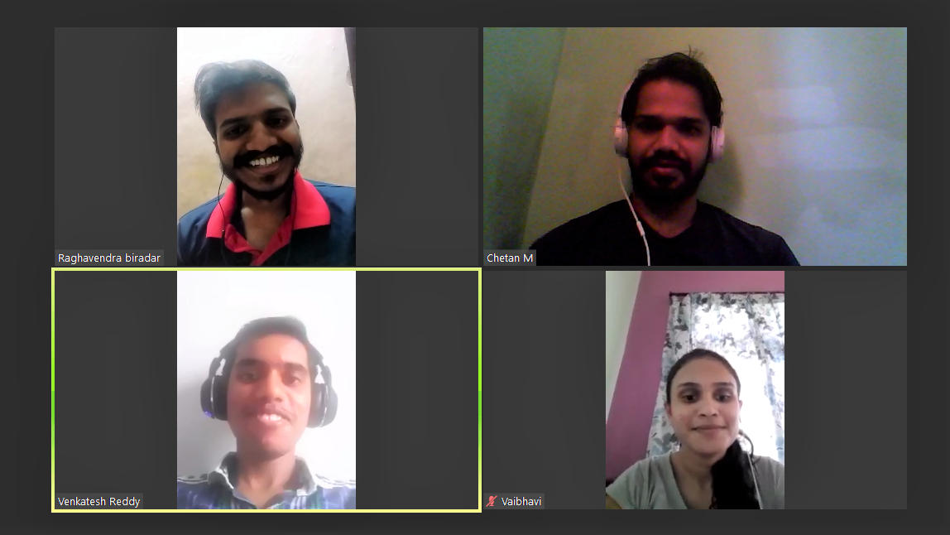
IBMHack 2020
Q & A
“It was an excellent occasion for us to team up, don the thinking hats, and pickle our brains”
Thank You !

